Slide 1






Home
About Us
Contact
Page 001
TradeKE
Insights
exports vs imports
By Chelah

Slide 2



TradeKE Insights
Home
About Us
Page 002
Problem
Kenya faces persistent trade deficits and economic vulnerabilities due to heavy reliance on imported manufactured goods and petroleum products while depending on a narrow range of agricultural exports. This study analyzes Kenya's import-export patterns from 2020-2024 to identify structural trade imbalances, assess the impact of global economic shocks (including COVID-19), and recommend strategies for improving trade competitiveness and reducing external dependencies.
Statement
Kenya's trade landscape has undergone significant transformation between 2019 and 2024, marked by a persistent and widening trade deficit that has more than doubled from $4.4 billion to over $10 billion. This comprehensive analysis reveals critical patterns in import dependency, export diversification challenges, and emerging opportunities for economic resilience.
This report synthesizes trade data from credible sources to provide actionable insights for policymakers, business leaders, and development partners seeking to enhance Kenya's trade competitiveness and economic sustainability through evidence-based decision making.

Slide 3

TradeKE Insights
Home
About Us
Page 003
Research
Questions
Quantify Kenya's trade deficit trends and underlying drivers
Identify import substitution opportunities and value addition potential
Analyze seasonal trade patterns and COVID-19 recovery dynamics
Develop strategic recommendations for trade balance improvement
Assess export diversification and competitiveness opportunities
Analysis Timeframe & Coverage
Period:2019 - 2024
Geographic Scope: Republic of Kenya vs global scope
Trade Partners: Global analysis

Slide 4

TradeKE Insights
Home
About Us
Page 004
Data
Prep
1. Data Input
Raw CSV file processing and validation
Schema verification for data integrity
Tech Stack: Excel, Python, CSV Parser
2. Data Cleaning
Prepare Data for Analysis
Missing value imputation strategies
Categorical variable encoding
Outlier detection and handling
Tech Stack: Pandas, NumPy
3. Data Storage
Persist Clean Data
Relational database schema design
Optimized data insertion with indexing
Tech Stack: MySQL, Excel
4. Data Transformation
Analytics-Ready Processing
Complex SQL queries and aggregations
Feature engineering for model preparation
Tech Stack: SQL, Pandas,
5. Visualization
Interactive Dashboard Creation
Dynamic chart generation
Real-time filtering capabilities
Tech Stack: Tableau

Slide 5
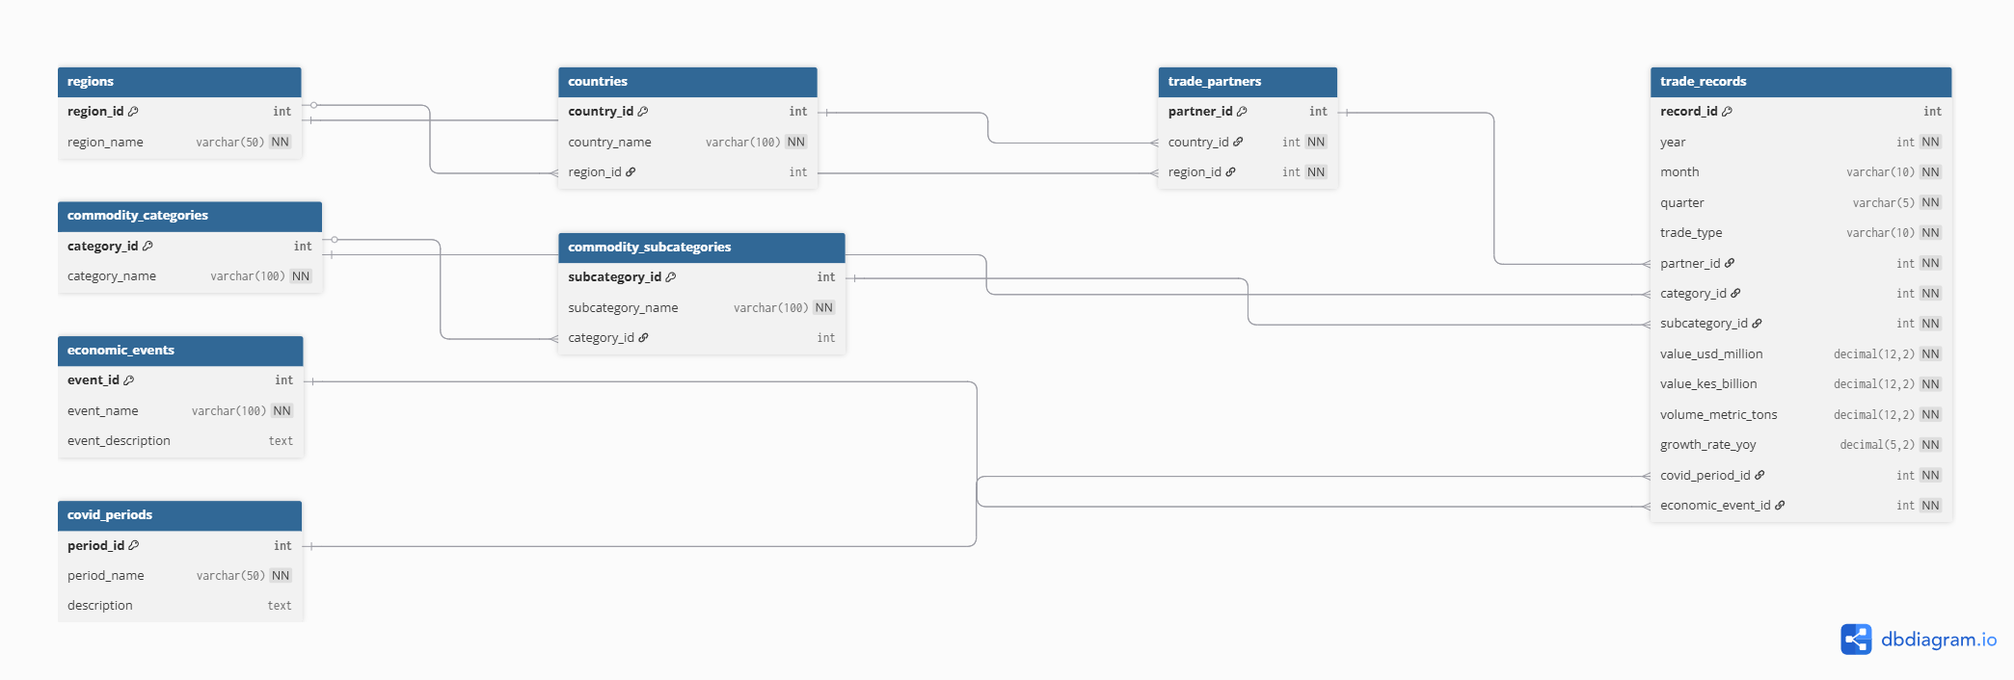
TradeKE Insights
Home
About Us
Page 005
ER.
Diagram

Slide 6
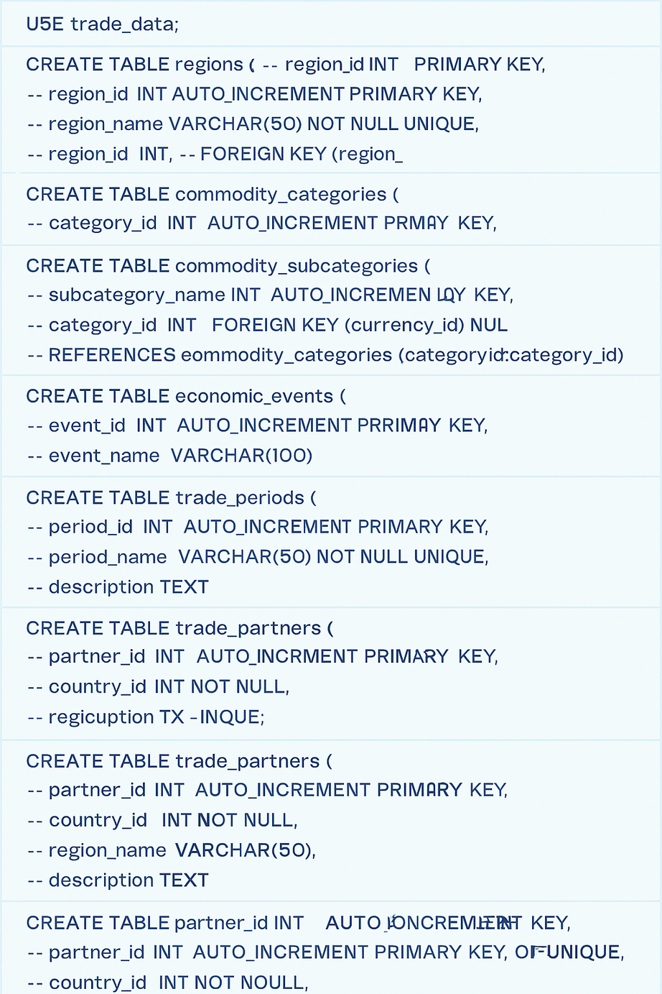
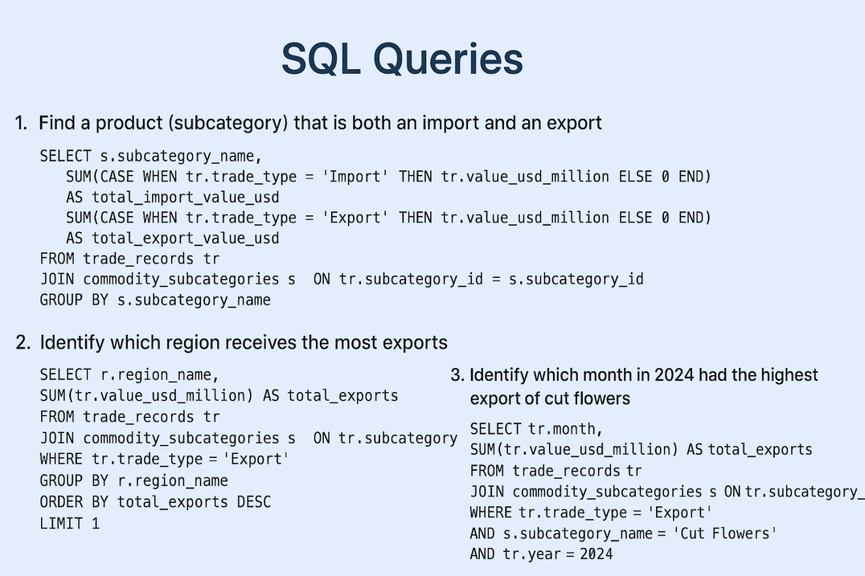
TradeKE Insights
Home
About Us
Page 006
SQL.
Implementation
Sample
Analysis
Queries

Slide 7

Home
About Us
Contact
Page 007
Visualisations...
from insights to impact

Slide 8
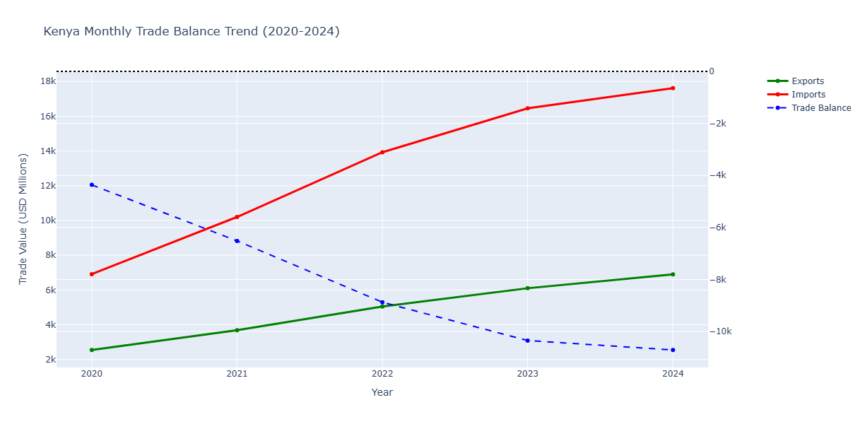
TradeKE Insights
Home
About Us
Page 008
Trade
Balance
INSIGHTS
Kenya's trade deficit reached $1.1 billion in December 2024, reflecting the persistent import-export gap.
Tea exports achieved record earnings of Kshs 180.57 billion in 2023 (31% increase), contributing to gradual export growth.
However, the goods trade deficit is projected to widen to 10.8% of GDP, the widest since 2018. By August 2024, tea exports had already surpassed 2023's total by Sh21 billion, reaching Sh127 billion.
This trend is driven by several key factors:
Kenya imports all its petroleum requirements, with 90% being refined products (petrol, diesel, kerosene), creating a substantial fuel import bill that widens the deficit.
Trade deficits are largely driven by increased expenditure on manufactured materials and industrial goods imports, including machinery orders, as Kenya's manufacturing sector relies heavily on imported raw materials and equipment.
RECOMMENDATIONS
"SHORT-TERM (1-2 years): - Accelerate agricultural value addition and expand market diversification beyond traditional routes - Leverage favorable trade agreements - maximize EU trade deal benefits and pursue pending US agreement - Focus on export quality premiums for higher-value agricultural products
MEDIUM-TERM (3-5 years): - Import substitution strategy - develop domestic manufacturing capacity - Enhance export diversification beyond agricultural commodities - Strengthen regional trade partnerships in East and Central Africa
LONG-TERM STRATEGIC: - Industrial transformation toward higher value-added exports - Infrastructure development to reduce export costs and enhance competitiveness"

Slide 9
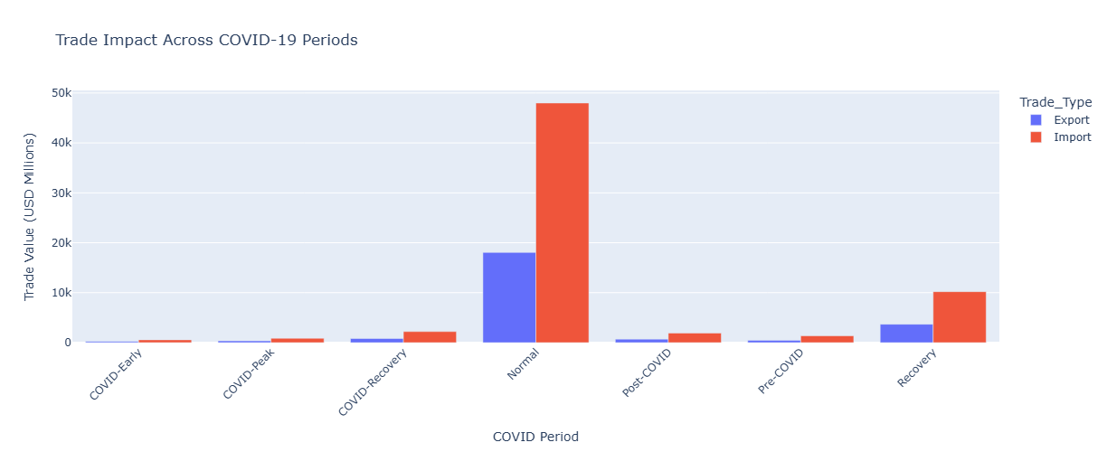


TradeKE Insights
Home
About Us
Page 009
COVID 19
Periods
INSIGHTS
"Kenya's trade was severely disrupted during COVID-19, with imports reducing by 15-23% and exports declining by 25-35% during the pandemic's peak periods.
The dramatic difference between 'Normal' and COVID periods reflects the shutdown of manufacturing industries dependent on industrial supplies and the suspension of international travel that severely impacted the accommodation and restaurant sectors.
Trade relationships recovered relatively swiftly by June 2020, following a similar trajectory through end-2020, but saw another decline in early 2021 due to rising COVID-19 cases and social distancing requirements.
The recovery period shows gradual restoration of trade volumes, though supply chain disruptions continued to impact Kenya's trade performance.
Despite depth of the economic crisis, regional trade in East Africa showed significant resilience from May 2020 onwards, contributing to the overall recovery trajectory."
RECOMMENDATIONS
LONG-TERM RESILIENCE
Create strategic reserves for critical imports and develop supply chain early warning systems
Build collaborative trading partner networks
Strengthen local essential sector production
IMMEDIATE CRISIS RESPONSE
Diversify supply chain sourcing countries
Build domestic manufacturing capacity
Enhance digital trade platforms
POST-PANDEMIC RECOVERY
Leverage African Continental Free Trade Area
Invest in resilient technology solutions
Rebuild tourism with safety protocols

Slide 10
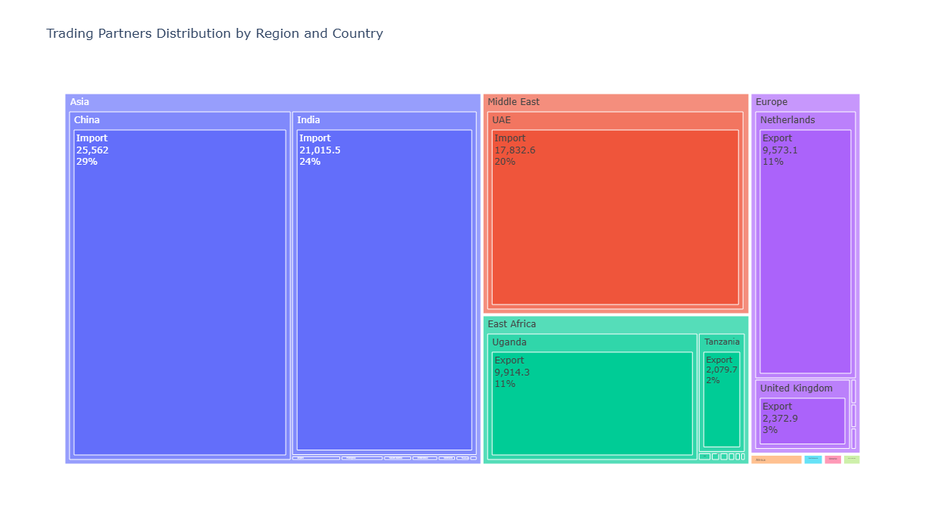
TradeKE Insights
Home
About Us
Trade
Partners
Page 010
INSIGHTS
"Kenya's trade is heavily skewed toward Asia, with China and India accounting for 53% of major partnerships. This concentration stems from China's Belt and Road Initiative, which has reshaped sub-Saharan Africa through strategic infrastructure investments, trade agreements, and economic diplomacy since the 2000s.
The UAE has leapfrogged India to become Kenya's second-largest source market due to soaring oil prices, as Kenya imports costly petroleum products.
China's dominance reflects Kenya's role as a pivotal maritime BRI location, with Chinese state-owned and private firms establishing extensive infrastructure, trade, and manufacturing projects.
Meanwhile, Kenya exports primarily to East African neighbors (Uganda, Tanzania) leveraging regional integration, and to European markets (Netherlands, UK) through established colonial-era trade links and recent EU trade agreements.
This creates a structural imbalance - large import dependencies on manufactured goods and energy from Asia/Middle East versus smaller regional agricultural and raw material exports."
RECOMMENDATIONS
- REDUCE DEPENDENCY: Diversify suppliers beyond China/India to Japan, South Korea, Vietnam and ASEAN countries
- STRENGTHEN REGIONAL TRADE: Maximize AfCFTA benefits and boost exports to East African neighbors (Uganda, Tanzania)
- EXPAND EUROPEAN MARKETS: Leverage EU trade deal beyond current Netherlands/UK partnerships - DEVELOP MANUFACTURING HUB: Position Kenya as regional value-added production center
- BALANCE PARTNERSHIPS: Maintain flexible relationships between Eastern and Western trading blocs - ENERGY TRANSITION: Reduce UAE petroleum dependency through renewable energy development
- CREATE SPECIAL ZONES: Establish targeted economic zones for specific regional export markets"

Slide 11
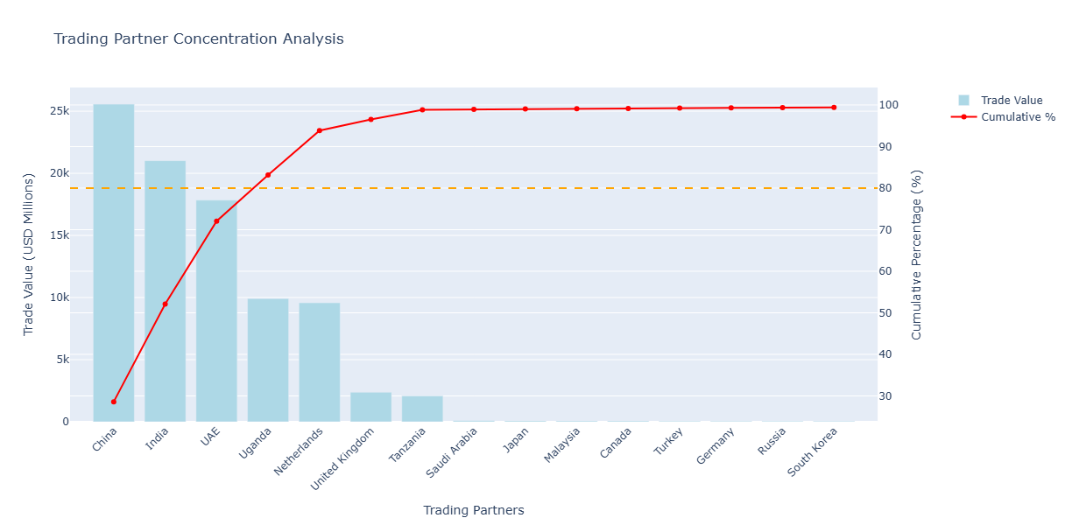
TradeKE Insights
Home
About Us
Trading
Partners
INSIGHTS
Page 011
Kenya exhibits severe trade concentration risk, with the top 5 trading partners (China, India, UAE, Uganda, Netherlands) accounting for approximately 80% of total trade value.
This concentration stems from Kenya's role as a regional trade hub under China's Belt and Road Initiative, which has intensified economic relationships with Asian partners.
The 80% threshold concentration in just 5 partners creates significant vulnerability to external shocks, currency fluctuations, and geopolitical tensions.
Kenya's participation in regional trade blocs such as the East African Community and bilateral arrangements aims at trade diversification, but the concentration pattern persists due to Kenya's import dependency on manufactured goods from Asia and petroleum from the Middle East.
The steep cumulative curve indicates that beyond the top 5 partners, remaining trading relationships contribute minimally to overall trade volume, highlighting the need for broader market diversification to reduce economic vulnerability.
RECOMMENDATIONS
- DIVERSIFICATION IMPERATIVE: Reduce top-5 concentration through targeted market expansion
- GEOGRAPHIC REBALANCING: Increase trade with African, European, and American partners to reduce Asian dependency
- SECTOR DIVERSIFICATION: Develop new export products to access untapped markets beyond current partner base
- REGIONAL INTEGRATION: Leverage AfCFTA to distribute trade risk across 54 African markets
- CONTINGENCY PLANNING: Create alternative supply chains for critical imports to manage concentration risks
- MONITOR CONCENTRATION: For instance setting maximum thresholds (no partner >25%, top-3 <60%) and track quarterly"

Slide 12
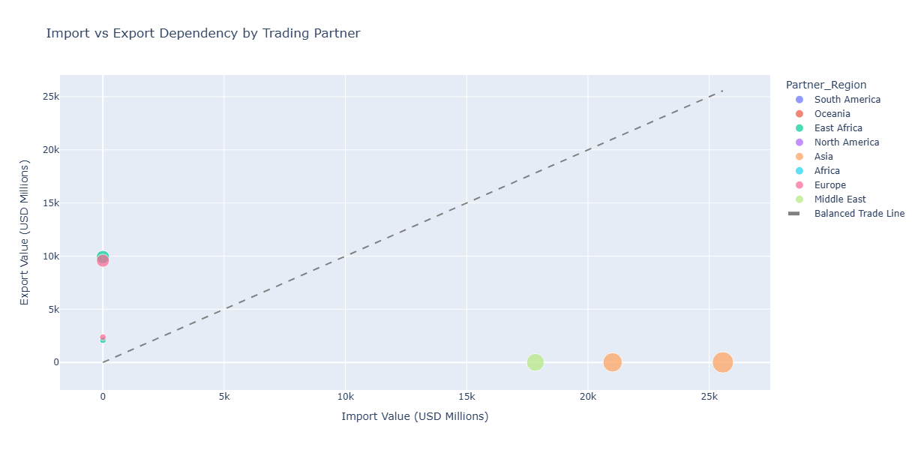
TradeKE Insights
Home
About Us
Page 012
Import -
Export
INSIGHTS
"Kenya exhibits extreme trade dependency patterns - massive import relationships with Asian partners (China, India, UAE) clustered on the import axis, while export relationships concentrate with East African neighbors and European markets on the export axis.
This polarization stems from Kenya's role as a regional manufacturing and trade hub, where the country imports crude petroleum, chemicals, manufactured goods, machinery, and transportation equipment primarily from Asia, while exporting agricultural products, processed goods, and re-exports to regional markets.
Kenya achieved a record $1.2 billion trade surplus with Africa in 2023, with Tanzania becoming Kenya's largest East African market, overtaking Uganda.
However, Kenya runs severe deficits with major Asian suppliers, creating the structural imbalance visible in this chart where no major partner approaches the balanced trade line."
RECOMMENDATIONS
- DEVELOP TWO-WAY TRADE: Convert one-way relationships into balanced partnerships by identifying export opportunities to current import partners
- REGIONAL VALUE CHAINS: Leverage Africa trade surplus ($1.2bn in 2023) to expand manufacturing for Asian markets
- IMPORT SUBSTITUTION: Reduce Asian import dependency by developing domestic production in key categories
- STRATEGIC POSITIONING: Use Kenya's regional hub status to facilitate triangular trade relationships
- NEGOTIATE BALANCE: Include export promotion clauses in import agreements with major Asian partners
- MONITOR DEPENDENCIES: Track import-export ratios and set targets to move partners closer to balanced trade line

Slide 13
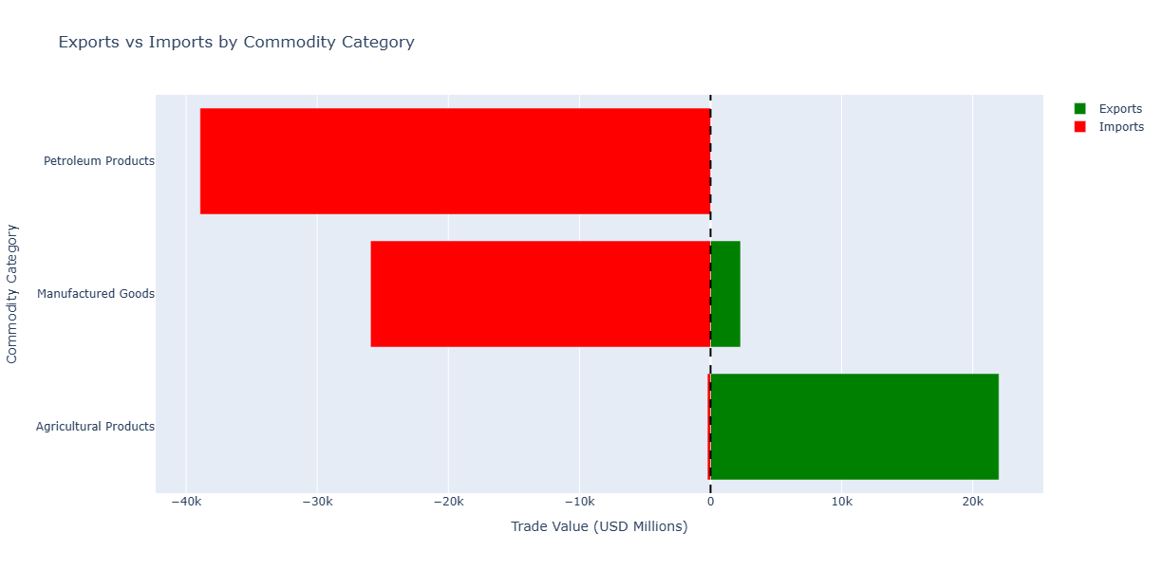
TradeKE Insights
Home
About Us
Page 013
Commodity
Analysis
"Kenya exhibits stark commodity-based trade imbalances that explain the overall deficit structure.
Petroleum products create the largest deficit with zero domestic production, as Kenya's oil import bill reached Sh575.5 billion in 2024 despite declining by 8.1%.
The country imports all petroleum requirements with 90% being refined products.
Manufactured goods show severe import dependency with minimal export capacity, as trade deficits widen largely on increased expenditure on manufactured materials.
However, agricultural products represent Kenya's competitive advantage, generating substantial export surpluses through tea, coffee, and horticultural products. Tea exports alone achieved record earnings of Ksh 180.57 billion in 2023, demonstrating Kenya's agricultural export strength.
This commodity pattern reveals that Kenya's trade deficit stems from structural dependencies on imported energy and manufactured goods, partially offset by agricultural export competitiveness."
INSIGHTS
RECOMMENDATIONS
- ENERGY TRANSITION: Accelerate renewable energy adoption to reduce petroleum import dependency of Sh575.5 billion annually
- DOMESTIC REFINING: Develop local petroleum refining capacity to add value and reduce refined product imports
- MANUFACTURING DEVELOPMENT: Implement import substitution for key manufactured goods through targeted industrial policy
- VALUE-ADDED AGRICULTURE: Expand processing of agricultural exports to capture higher margins and reduce raw material dependence
- INDUSTRIAL DIVERSIFICATION: Develop manufacturing exports in sectors where Kenya has regional competitive advantages
- GREEN ENERGY MANUFACTURING: Position Kenya as regional hub for renewable energy equipment production
- REGIONAL VALUE CHAINS: Integrate into East African manufacturing networks to reduce import costs

Slide 14
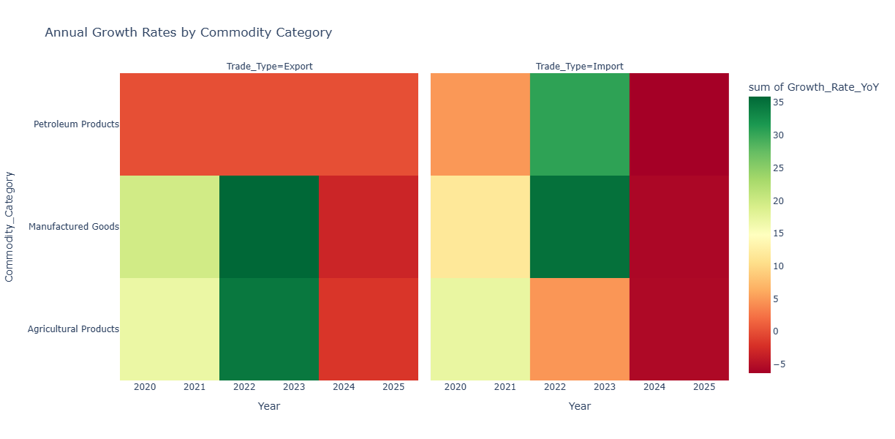
TradeKE Insights
Home
About Us
Page 014
Commodity-wise
Growth
INSIGHTS
Kenya's commodity growth patterns reveal significant volatility driven by external shocks and recovery cycles. Agricultural exports experienced exceptional growth in 2022-2023, with tea exports achieving record earnings of Kshs 180.57 billion in 2023 (31% increase) due to increased volumes and favorable exchange rates.
However, agricultural export growth faces challenges from climate variability, global price fluctuations, and exchange rate volatility that particularly impacts coffee exports to European markets.
Import growth shows high volatility across all categories, reflecting Kenya's susceptibility to global supply chain disruptions, energy price shocks, and currency fluctuations.
The declining growth rates in 2024-2025 depict economic headwinds from inflation, high interest rates, and reduced consumer demand affecting both export competitiveness and import capacity
RECOMMENDATIONS
- AGRICULTURAL RESILIENCE: Develop climate-smart agriculture and irrigation systems to reduce weather-related volatility in export growth
- CURRENCY HEDGING: Implement financial instruments to protect exporters from exchange rate volatility impacts
- SUPPLY CHAIN EFFICIENCY: Invest in logistics infrastructure to maintain export competitiveness during global disruptions
- IMPORT OPTIMIZATION: Develop strategic procurement policies to smooth import growth volatility and reduce costs
- MANUFACTURING SCALING: Accelerate industrial development to capture higher and more stable manufactured export growth
- REGIONAL INTEGRATION: Leverage AfCFTA to create more predictable growth patterns through regional trade stability

Slide 15
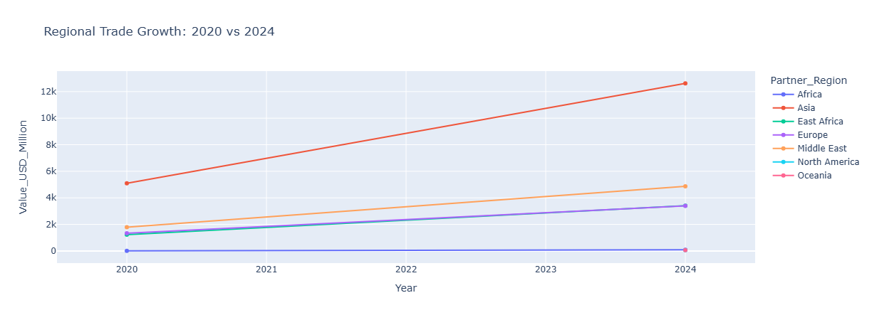
TradeKE Insights
Home
About Us
Page 015
Region-wise
Growth
INSIGHTS
Kenya's regional trade patterns reveal a decisive shift toward Asian markets during the 2020-2024 period, with Asia showing the steepest growth trajectory from post-COVID recovery.
This growth reflects Kenya's increasing integration with Asian supply chains, driven by China's BRI infrastructure investments and rising import dependency on manufactured goods and machinery.
East Africa remains Kenya's strongest export region despite slower growth, benefiting from regional integration efforts and Kenya's role as a regional hub.
Despite challenges like climate events and conflicts, East Africa remains the fastest-growing region in Africa, with Kenya maintaining its position as one of the best performing economies in sub-Saharan Africa.
- BALANCE ASIAN DEPENDENCY: While leveraging Asian growth, develop export capabilities to create two-way trade relationships
- ACCELERATE EAST AFRICA INTEGRATION: Maximize the region's fastest-growing status by expanding manufacturing for regional markets
- STRENGTHEN EUROPEAN PARTNERSHIPS: Build on steady European growth through value-added agricultural exports and EU trade agreements
- DIVERSIFY MIDDLE EAST RELATIONS: Beyond petroleum imports, explore renewable energy cooperation and services exports
- REVITALIZE NEGLECTED MARKETS: Develop strategies for North America and Oceania where Kenya has untapped potential
RECOMMENDATIONS

Slide 16

TradeKE Insights
Home
About Us
Page 016
Conclusion
Strategic Opportunities
Critical Risks
Agricultural Value Addition
Processing raw exports could increase unit values by 400-600%, transforming Kenya into a regional agro-industrial hub.
Debt Sustainability
Persistent trade deficits strain foreign reserves and increase external debt vulnerability to currency fluctuations.
Import Substitution
$2.1 billion potential savings through domestic rice and sugar production, creating 500,000+ jobs in rural areas.
Import Dependency
2:1 import-export ratio creates exposure to global supply chain disruptions and commodity price volatility.
Regional Trade Leadership
AfCFTA implementation could position Kenya as the manufacturing hub for East Africa's 300+ million consumers.
Industrial Competitiveness
Without rapid industrialization, Kenya risks becoming a permanentraw material exporter in global value chains.

Slide 17

Strategic
Recommendations
Page 017
Phased approach to address trade imbalances and economic vulnerabilities
Long-term Vision
(3–5 years)
Economic Diversification
•Achieve$20B total exports by 2030
•Reduce trade deficit to<$3B
•Manufacturing to comprise30%of exports
Regional Leadership
•Become regional hub for processed goods
•Lead East African value chain integration
•Establish AfCFTA trade corridor
Technology & Innovation
•Digital trade platform for SME exports
•Block chain supply chain traceability
•Green industrialization for sustainability
Immediate Actions
(0–12 months)
Import Substitution
•Launch rice production incentives targeting 50% self-sufficiency within 12 months
•Revitalize sugar factories in Nyanza and Western regions
•Establish emergency grain reserves to reduce wheat import dependency
Trade Finance & Policy
•Implement strategic import tariffs on non-essential manufactured goods
•Launch export credit guarantee scheme for SME manufacturers
•Negotiate bilateral trade agreements with Uganda and Tanzania
Medium-term
(1–3 years)
Industrial Development
•Establish agro-processing SEZs in coffee and tea regions
•Launch textile manufacturing hubs targeting export markets
•Develop pharmaceutical manufacturing to serve East African market
Value Addition
•Target $150/kg unit values for processed coffee exports
•Expand cut flower varieties and cold chain infrastructure
•Develop leather processing from raw hide exports

Slide 18
TradeKE Insights
Home
About Us
Page 018
Data
Sources
WITS - World Integrated Trade Solution
Relief Web
UN Comtrade
KenTrade
Trading Economics
kIPPRA

Slide 19
Home
About Us
Contact
Thank
You!
from insights to impact
By Chelah

